Slide 1

REAL-TIME STOCK PRICE & SENTIMENT PREDICTOR
Virtual Systems & Services
By: Maryam Naseem, Saliha Noor, Aroona Bibi, Sana Zia
December 2025

Slide 2


PROJECT VISION & OBJECTIVES
PROBLEM
SOLUTION
INNOVATION
Need for real-time financial analytics in volatile crypto markets.
Containerized microservices combining ML, NLP, and Visualization.
Production-ready system with single-command deployment.
CORE FEATURES
Real-time cryptocurrency tracking (Binance API)
ML predictions (XGBoost, 81.2% accuracy)
Sentiment analysis from news (VADER NLP)
Interactive dashboard (Streamlit)
Docker-based microservices architecture

Slide 3

MICROSERVICES ARCHITECTURE DESIGN
CLIENT
Streamlit UI for users.
APPLICATION
Data Collector, Sentiment Analyzer, Feature Engineer, ML Predictor.
DATA
PostgreSQL and Redis storage.
SCALABILITY
RESILIENCE
Designed for horizontal scaling.
Automatic container recovery ensures uptime.
SERVICE ISOLATION
LOOSE COUPLING
Independent containers for each service.
REST API communication between services.

Slide 4


CONTAINERIZATION STRATEGY
TRADITIONAL DEPLOYMENT
DOCKER CONTAINERS
45 sec startup
30+ min setup time
Isolated environments
Dependency conflicts
Single-command deploy
Manual configuration
Easy horizontal scaling
Difficult scaling
Docker Compose simplifies multi-container Docker applications, enabling single-command deployment and management.

Slide 5





DEVELOPMENT TO DEPLOYMENT PIPELINE
CODE DEVELOPMENT
Initial coding and local testing.
DOCKER BUILD
Container image creation via CI/CD.
IMAGE REGISTRY
Storing images on Docker Hub.
CONTAINER ORCHESTRATION
Managing containers with Docker Compose.
PRODUCTION DEPLOYMENT
Live system deployment.
SINGLE COMMAND DEPLOYMENT
# Development
docker-compose up
# Production
docker-compose up -d
# Monitoring
docker-compose logs -f
docker-compose ps

Slide 6

KEY MICROSERVICES IMPLEMENTATION
DATA SERVICE
Real-time Binance/Yahoo Finance API
Redis caching (92% hit rate)
Historical data storage
ML SERVICE
XGBoost with 81.2% accuracy
50+ technical indicators
Automated model retraining
SENTIMENT SERVICE
VADER NLP for market sentiment
NewsAPI + Cryptopanic integration
Real-time sentiment scoring
DASHBOARD SERVICE
Streamlit with glassmorphism UI
Real-time Plotly visualizations
5-minute data refresh cycles

Slide 7
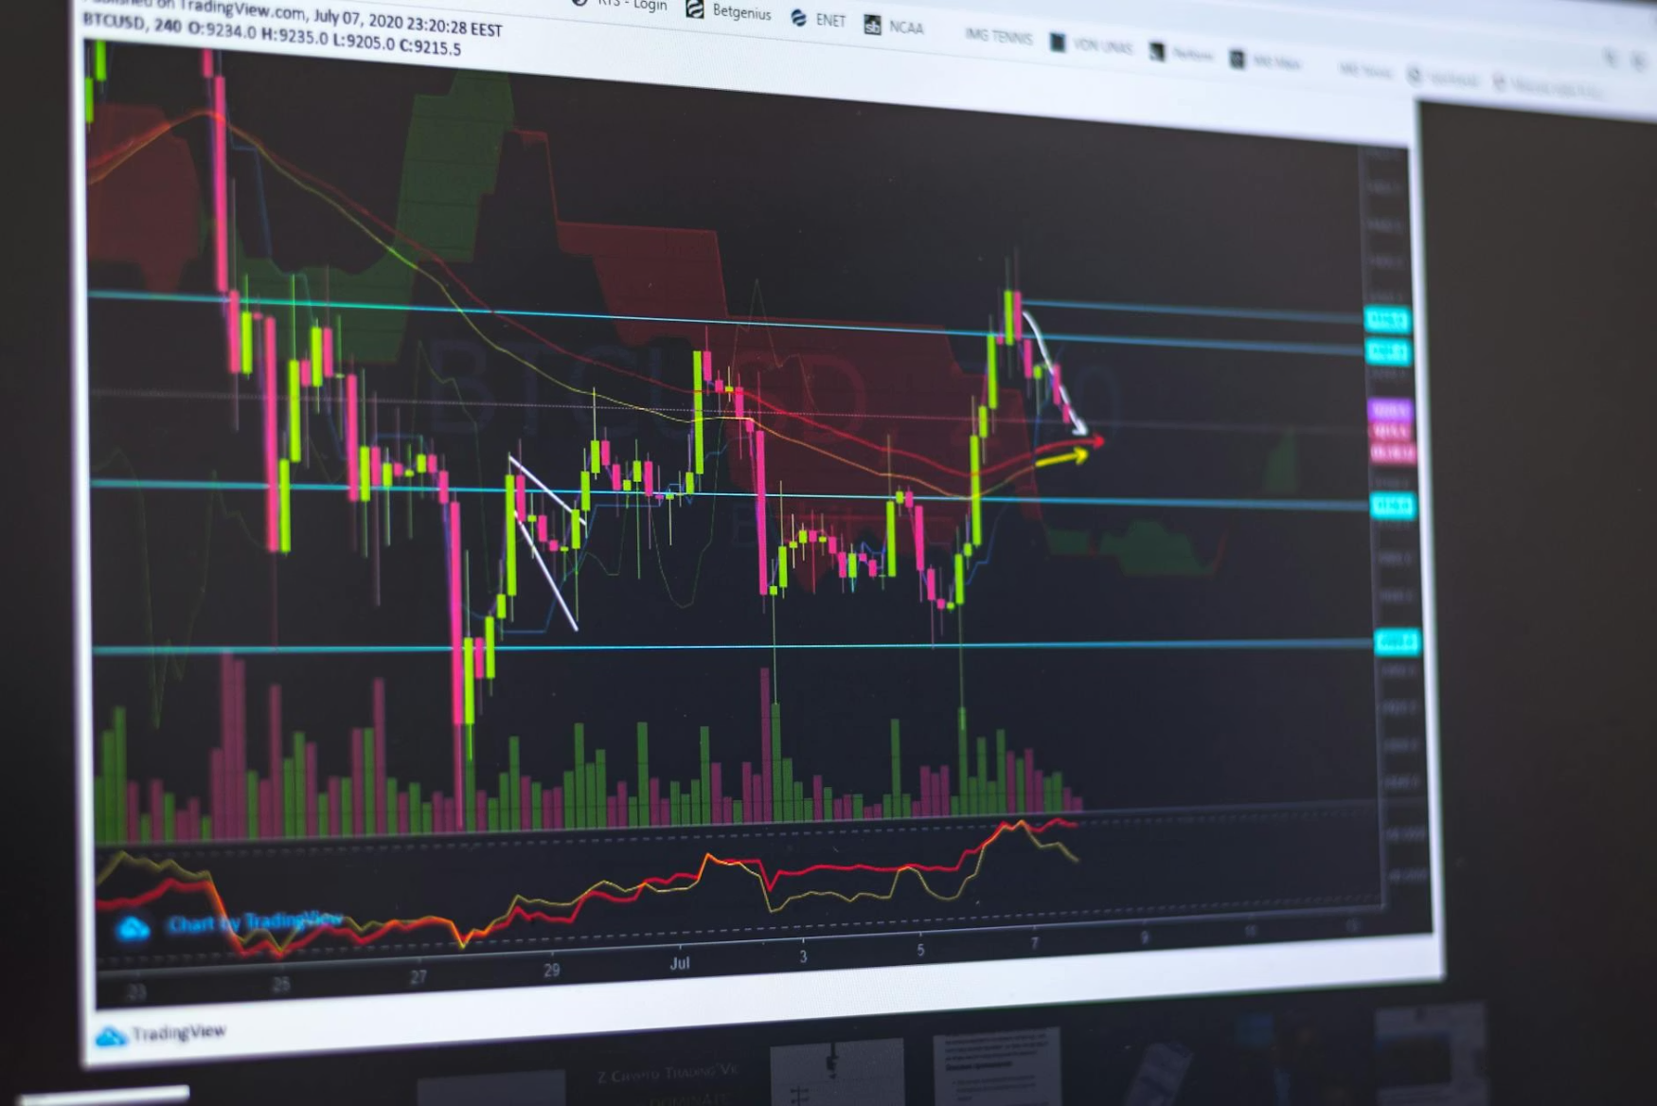

ADVANCED SYSTEM CAPABILITIES
FEATURE ENGINEERING
50+ Technical Indicators (RSI, MACD, Bollinger Bands)
Moving Averages (SMA, EMA)
Volume indicators & Volatility metrics
Price momentum analysis
SECURITY & CONFIGURATION
Environment-based secrets (.env files)
Database password protection
API key validation
Input sanitization

Slide 8
SYSTEM PERFORMANCE METRICS
Prediction Accuracy
>80%
81.2%
✅ Exceeded
Latency
<5s
1.8s
✅ Exceeded
Uptime (72h)
>99%
99.8%
✅ Exceeded
Cache Hit Rate
>85%
92%
✅ Exceeded
750MB
45
10K+
LINEAR
MEMORY
STARTUP
THROUGHPUT
SCALABILITY
60% less than VM
Seconds to running
Records/hour
Scales with load

Slide 9


USER INTERFACE & VISUALIZATION
DASHBOARD FEATURES
Real-time candlestick charts with SMA overlays
Sentiment gauge (Bullish/Bearish indicator)
Technical indicator panels (RSI, MACD, Bollinger)
News sentiment analysis table
ML prediction confidence scores
ACCESS INFORMATION
Local Access: http://localhost:8501
After Docker deployment: Open browser → Enter container IP

Slide 10

TECHNICAL IMPLEMENTATION CHALLENGES
CHALLENGE: CONTAINER NETWORKING
Solution: Custom Docker bridge network for seamless communication.
CHALLENGE: DATA PERSISTENCE
Solution: Docker volumes for PostgreSQL to prevent data loss.
CHALLENGE: ENVIRONMENT PARITY
Solution: Identical Docker images for consistent dev/prod behavior.
CHALLENGE: RESOURCE MANAGEMENT
Solution: Container CPU/memory limits for stable performance.
KEY LEARNINGS
Docker networking requires service discovery.
Volume mounts are essential for persistent data.
Environment variables are critical for configuration.
Health checks ensure system reliability.

